Slide 1
Extreme Event Selection Committee Report
J.S. Halekas. G.T. Delory, W.M. Farrell, R.M. Killen, M. Sarantos

Slide 2
Event Selection Criteria
Well-studied event
LP or other lunar plasma data available
Upstream energetic particle data available
Ground-based data available
EUV data available
“Interesting” sputtering/ion-enhanced-PSD inputs
High alpha/proton ratio
Heavy ion fluxes

Slide 3
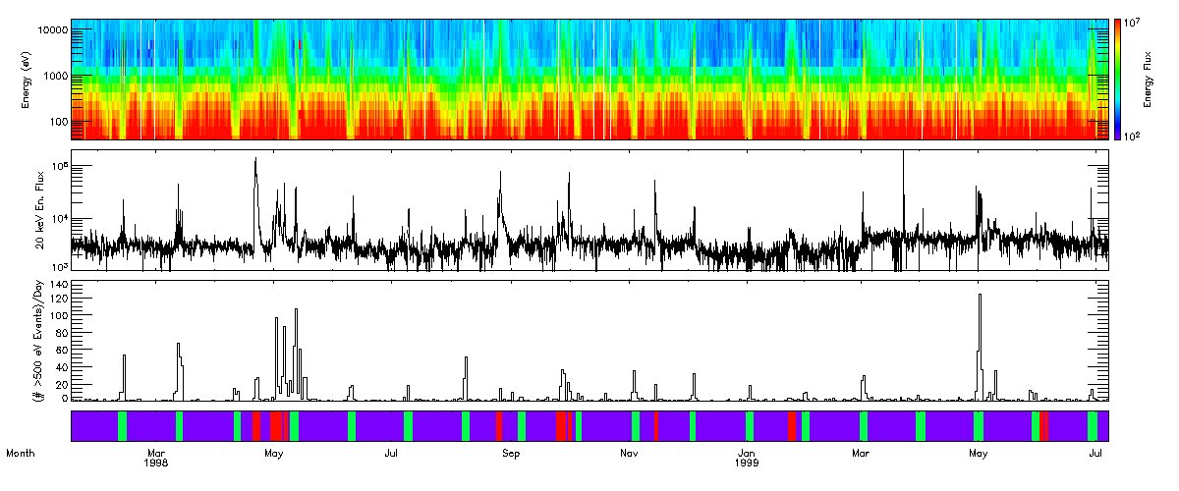
Starting Point: Plasma Data
Kaguya had best plasma data, but no extreme events!
So, looked for events during LP mission
Electron Energy Spectrum
High Energy Electrons
Frequency of >500 V charging
SEP Events Magnetotail Passages

Slide 4
Many Well-Studied 1998 Events
Event Periods #1,3,5,6,7,10,11 are flagged as Solar Particle Events that affected the terrestrial environment by NOAA
All events have extensive plasma data from upstream assets (Wind, ACE, SOHO) and at GEO
Event Periods #3 (May),#6 (August), and #7 (September) are ISTP Sun-Earth Connection Events
Extremely well-studied

Slide 5
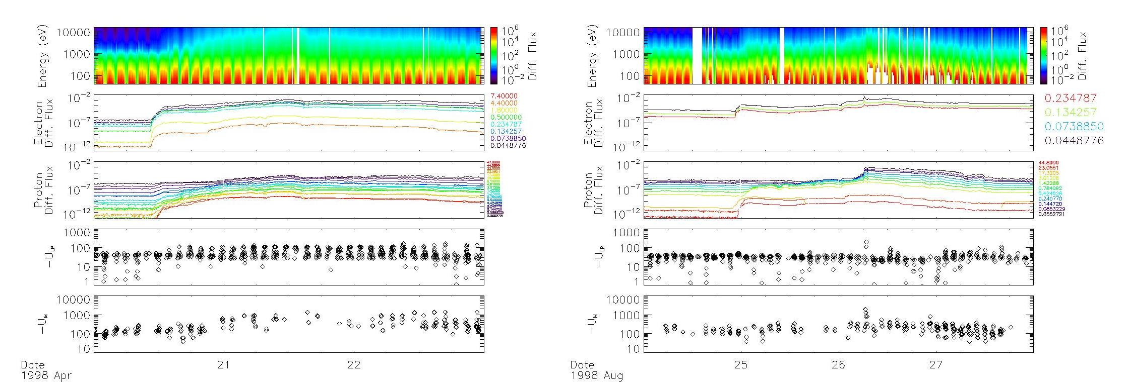
April & August 1998
Low energy and energetic electron fluxes, energetic ion fluxes, spacecraft potential, and lunar surface potential
Note the clear orbital modulation as LP (in polar orbit) passes through the lunar plasma wake

Slide 6
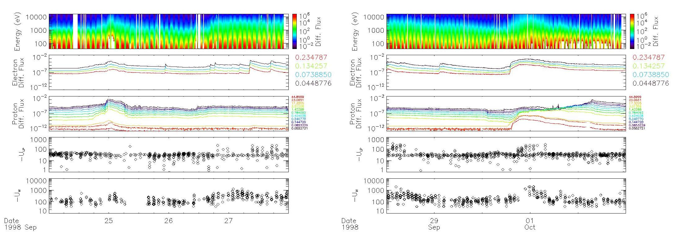
September/October 1998

Slide 7
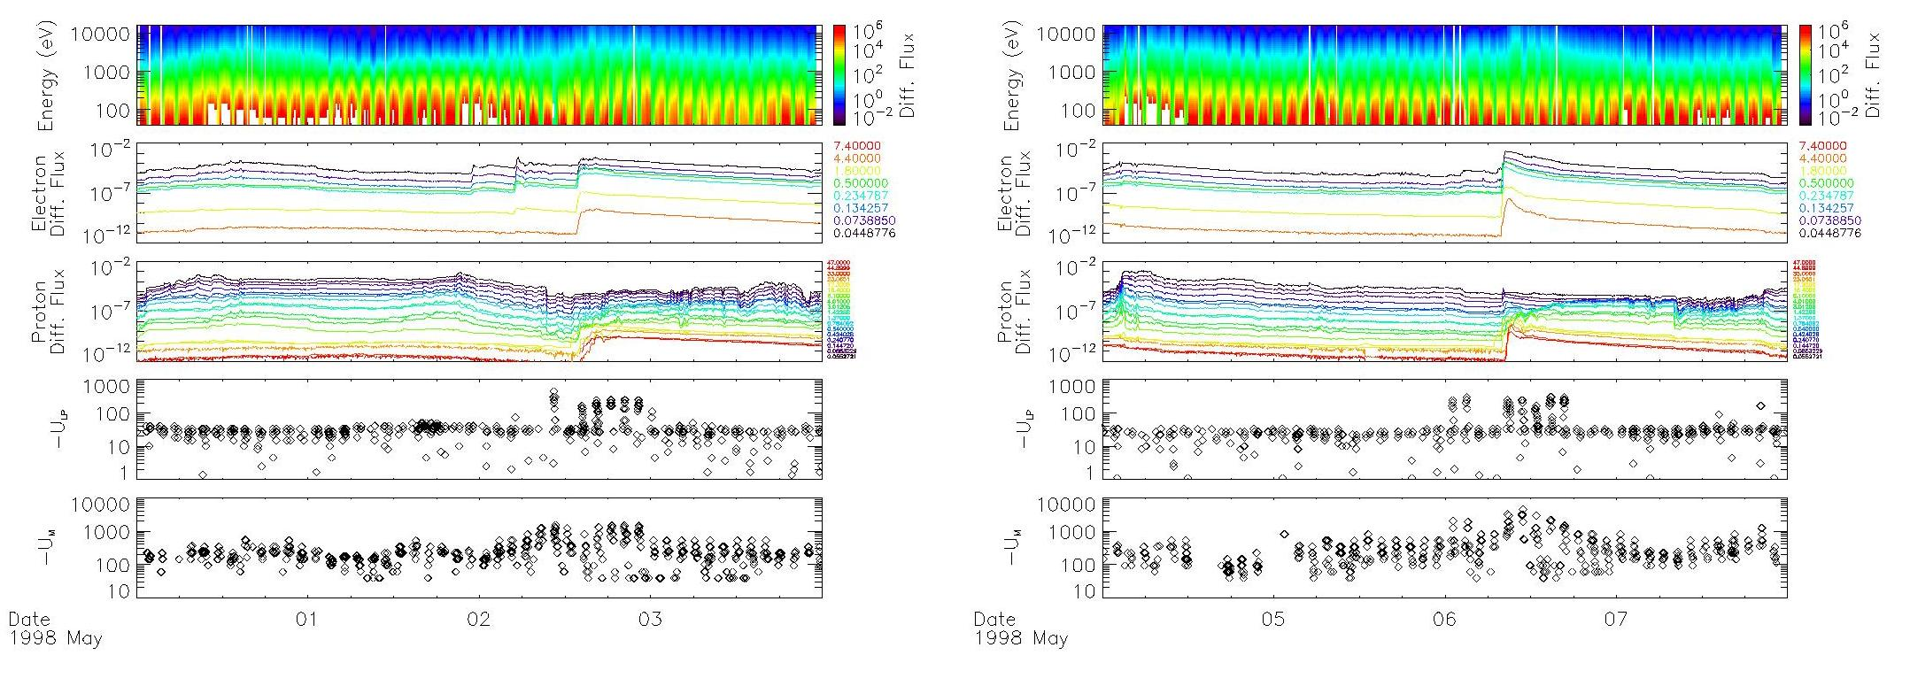
May 1998

Slide 8
Other Factors
High alpha/proton ratio for May, August, September events
Have NOT Checked EUV Availability
No ground-based data available during SEP event and during LP mission
May
Sep

Slide 9
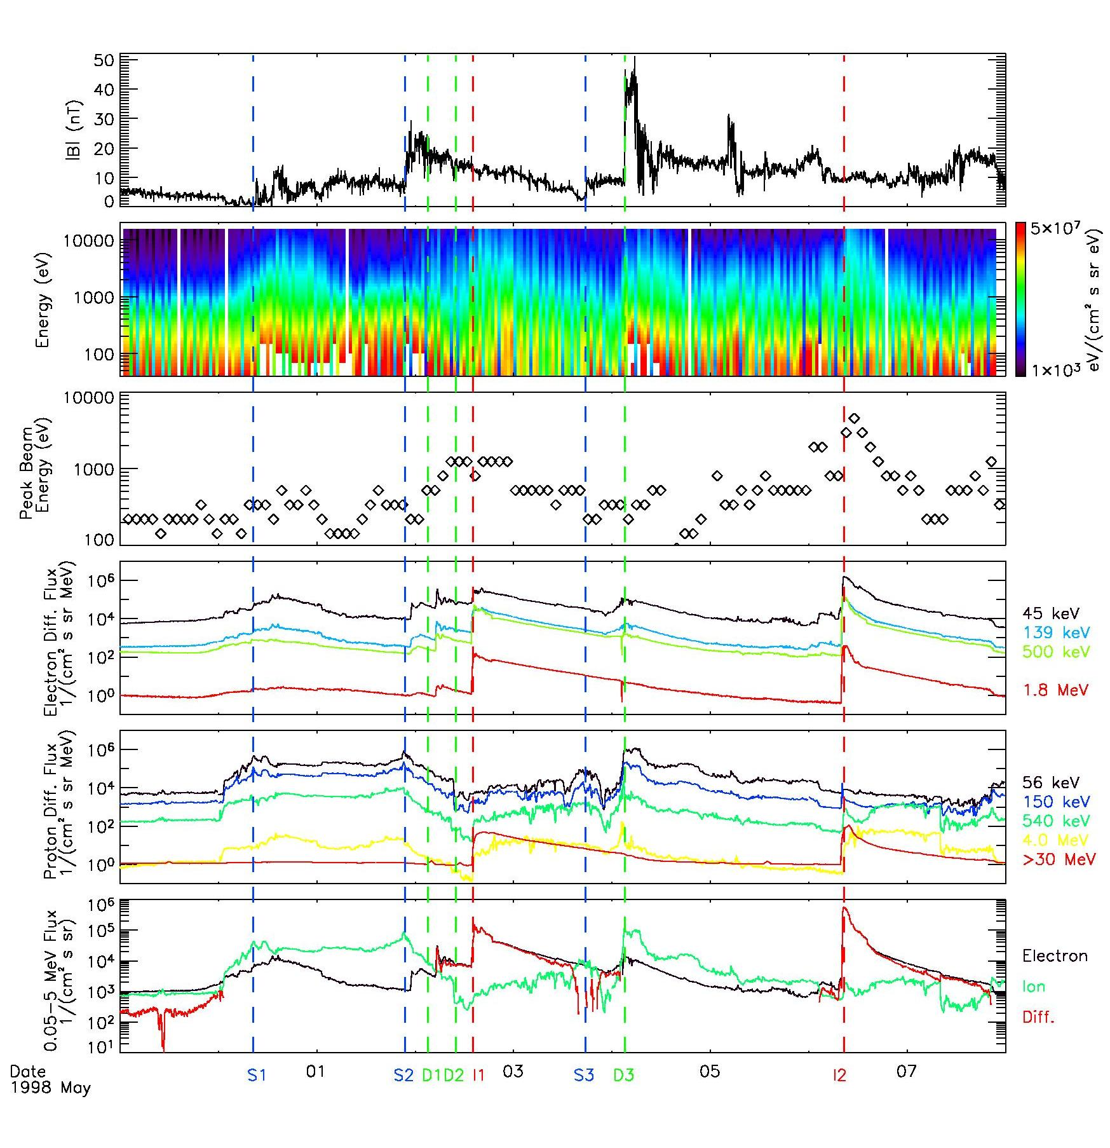
Recommendation: May 1998
Extraordinarily complicated time period
Multiple flares, CME shock passages, magnetic clouds, SEP injections
Should have something for everyone

Slide 10
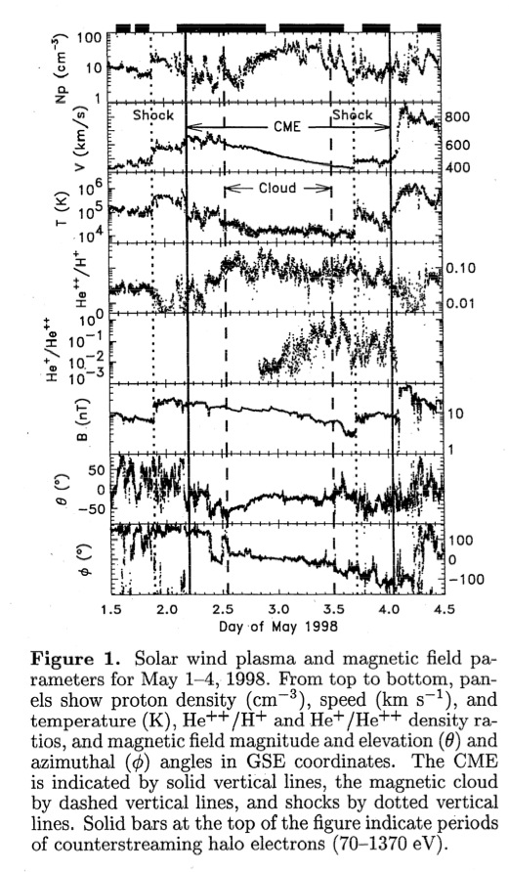
More on May 1998
Extensive library of references available
Lots of interesting studies of this event time period
For example, Skoug et al. at right looked at ratios of He+ and He++ during magnetic cloud passage
Could be very interesting for sputtering etc.

Slide 11
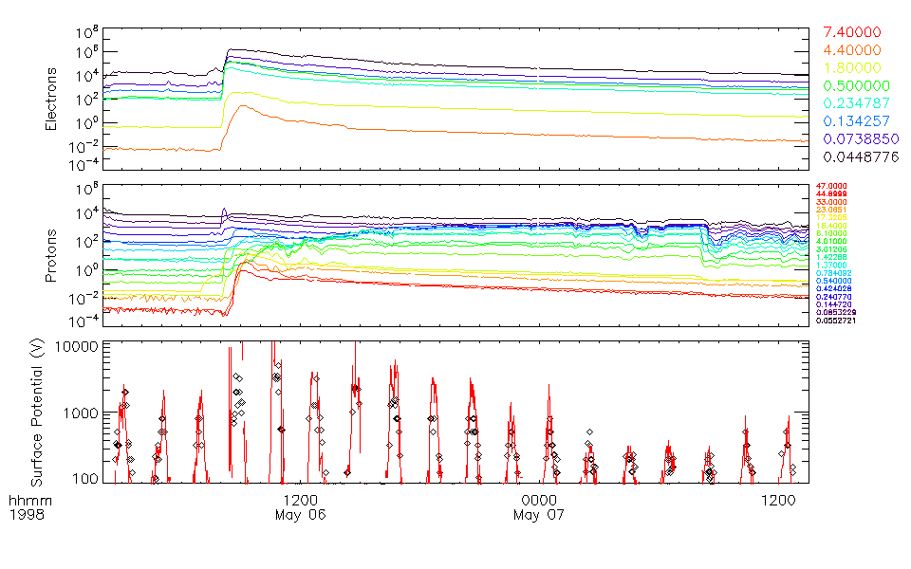
May 1998 Charging Modeling
Model
Data

Slide 12
Caveat
These events have everything
Great, because you can look at everything under the sun
Bad, because they are complicated to interpret
Suggestion
We model simple idealized cases first
1. Flare (just UV)
2. Shock passage (just B, n, T change)
3. SEP injection (just energetic particles)
Multiple composition, time profiles?
Then, tackle the big one

Slide 13
Extra Slides Follow

Slide 14
Complexity of Events
Reames,1999

Slide 15
Modeling Surface Charging
Find potential which ensures current balance between electrons, ions, secondary electrons, and photoelectrons (dayside only)
Lack measurements of low-energy ions
Assume T_{i}=T_{e},n_{i}=n_{e}
Use LP data to estimate secondary emission coefficents
J_{e}(U) + J_{i}(U) + J_{s}(U) + J_{ν}(U)= 0

Slide 16
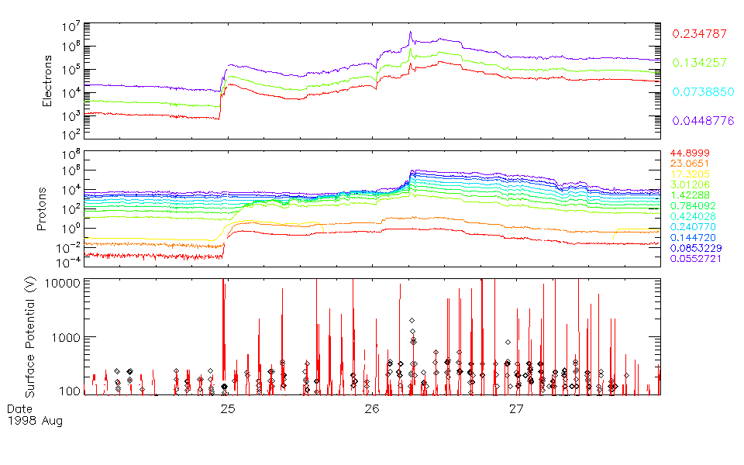
Aug. 1998 Charging Modeling

